Slide 1
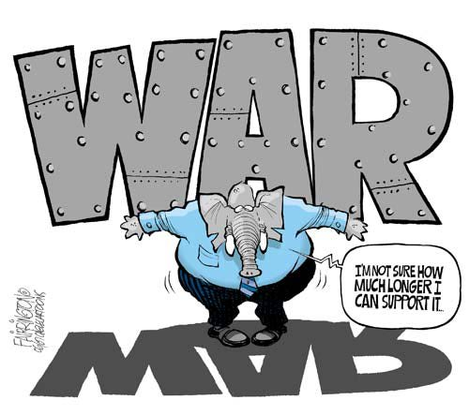
Language of War: Linguistic Differences in Political Discourse Involving Conflict
Kayla Jordan & Erin Buchanan
Missouri State University
0.tqn.com/d/politicalhumor/1/0/L/k/1/republican_war_support.jpg

Slide 2
War Language
Us versus Them: Use of euphemisms (e.g. liberation v. invasion) and hate speech (Bugarski, 2000)
Use of rhetoric and political myths to legitimize “war on terror” (Esch, 2010)
Exceptionalism, Civilizing Mission
Rise of militarist language (e.g. warrior) with Iraq War (Babones, 2012)

Slide 3
Hogenraad, 2005
Increased use of power words (e.g. legitimate, terrorize) with a decreased use of affiliation words (e.g. family, thoughtful) tend to precede war
Notes:
Break dup
Psychological distance: abstract, impersonal, and rational tone
Cognitive processing: organizing and intellectually understanding the issues
Depressive language was marked by high levels of 1st-person singular words (I; e.g., ‘‘I,’’ ‘‘me,’’ ‘‘my’’), physical words (physcal; e.g., ‘‘ache,’’ ‘‘sleep’’), negative emotion words (negemo; e.g., ‘‘hate,’’ ‘‘worthless’’), and low levels of positive emotion words (posemo; e.g., ‘‘happy,’’ ‘‘pretty’’).
Presidential language was marked by high levels of articles (article), prepositions (preps), positive emotions (posemo) and big words (sixltr)

Slide 4
Slatcher, Chung, Pennebaker, & Stone, 2007
Study of ‘04 presidential campaign: Democrats used more depressive language; Republicans more presidential language
Depressive language
Greater: 1st-person singular words, physical words, negative emotion words
Less: positive emotion words
Presidential language
More: articles, prepositions, positive emotions and big words

Slide 5
Cohn, Mehl, & Pennebaker, 2004
Study of blogs following 9-11
Two weeks following increased:
Negative,
Social,
Cognitive processing (organization and understanding), and
Distant (abstract, impersonal, and rational tone)
Distancing persisted. Cognitive processing declined

Slide 6
Tausczik and Pennebaker (2010)
“Style words reflect how people are communicating” (p.29)
Personal pronouns and verb tense linked to attentional focus
Social words linked to status and group cohesion
Cognitive complexity linked to exclusive words, conjunctions, prepositions, cognitive mechanisms, and longer words
Notes:
Last points only

Slide 7
LIWC
Language Inquiry and Word Count (LIWC; Pennebaker, Booth, & Francis, 2007)
Text analysis program
82 language categories
Fails to recognize context and sarcasm (Pennebaker, 2011)

Slide 8
Category | Examples | Words In Category | Alpha: Binary/Raw | Category | Examples | Words In Category | Alpha: Binary/Raw
Pronouns |  |  |  | Cognitive Mechanisms
1st pers singular | I, me, mine | 12 | .62/.44 | Insight | think, know, consider | 195 | .94/.51
1st pers plural | We, us, our | 12 | .66/.47 | Causation | because, effect, hence | 108 | .88/.26
2nd person | You, your, thou | 20 | .73/.34 | Discrepancy | should, would, could | 76 | .80/.28
3rd pers singular | She, her, him | 17 | .75/.52 | Tentative | maybe, perhaps, guess | 155 | .87/.13
3rd pers plural | They, their, they’d | 10 | .50/.36 | Certainty | always, never | 83 | .85/.29
Verbs |  |  |  | Inhibition | block, constrain, stop | 111 | .91/.20
Past tense | Went, ran, had | 145 | .94/.75 | Inclusive | And, with, include | 18 | .66/.32
Present tense | Is, does, hear | 169 | .91/.74 | Exclusive | But, without, exclude | 17 | .67/.47
Future tense | Will, gonna | 48 | .75/.02 | Relativity
Other |  |  |  | Motion | Arrive, car, go | 168 | .96/.41
Adverbs | Very, really, quickly | 69 | .84/.48 | Space | Down, in, thin | 220 | .96/.44
Articles | A, an, the | 3 | .14/.14 | Time | End, until, season | 239 | .94/.58
Prepositions | To, with, above | 60 | .88/.35 | Personal Concerns
Conjunctions | And, but, whereas | 28 | .70/.21 | Work | Job, majors, xerox | 327 | .91/.69
Negations | No, not, never | 57 | .80/.28 | Achievement | Earn, hero, win | 186 | .93/.37
Quantifiers | Few, many, much | 89 | .88/.12 | Money | Audit, cash, owe | 173 | .90/.53
Social processes |  |  |  | Religion | Altar, church, mosque | 159 | .91/.53
Social | Mate, talk, they, child | 455 | .97/.59 | Death | Bury, coffin, kill | 62 | .86/.40
Positive emotion | Love, nice, sweet | 406 | .97/.40
Negative emotion | Hurt, ugly, nasty | 499 | .97/.61
LIWC Categories (http://www.liwc.net/descriptiontable1.php)
Notes:
Handout

Slide 9
Purpose
We wished to explore the possibility of using this linguistic analysis to predict whether or not war will occur.
Notes:
Only second sentence

Slide 10
Hypotheses
The best models for predicting support for military action will use pronouns, social words, and emotional words as predictors.
The use of third person pronouns will be greater among those that support military action.
More positive emotion words will be used in support for military action and more negative for opposition.

Slide 11
Sample 1
Congressional Record, speeches in the Senate from 1998 to 2013 (248)
U.S. relations with the following countries: Iraq (198), Kosovo (50)
Number of US Senators: 92
Number of Speeches by Party Affiliation: Republican (136), Democrat (111)
Word count: M = 1757.54, SD = 1427.26, Mdn = 1483.00, Min = 124, Max = 12215

Slide 12
Sample 2
Congressional Record, speeches in the House from 1998 to 2013 (458)
U.S. relations with the following countries: Iraq (331), Libya (106), Kosovo (32)
Number of US Representative: 290
Number of Speeches by Party Affiliation: Republican (211), Democrat (258)
Word count: M = 757.54, SD = 1135.55, Mdn = 510, Min = 97, Max = 12165

Slide 13
Results
Dependent Measures
Voting records (Kosovo, Iraq, Libya)
Independent Measures
Linguistic processes, Pronouns, Verbs, Other function words, Social/emotional words, Cognitive mechanisms, Relativity words, and Personal concerns
Multilevel Logistic Regression
Notes:
Combine Method and Results

Slide 14
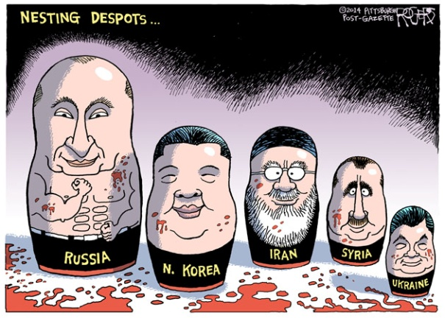
Results: Senate
Determine the need for a nested model
Level 1: Nested by Senator
Level 2: Nested by Senator and Region
Level 3: Nested by Senator, Region, and Party Affiliation
 | df | Deviance | LogLik | AIC | BIC | Deviance Difference | Δdf | p
Null Model | 242 | 305.02 |  | 307.02
Null Nested Model-Level 1 | 151 | 217.14 | -108.57 | 221.14 | 228.12 | 87.88 (114.17) | 91 | >.05
Null Nested Model-Level 2 | 149 | 193.75 | -96.87 | 199.75 | 210.23 | 111.27 (116.51) | 93 | >.05
Null Nested Model-Level 3 | 147 | 199.51 | -99.75 | 207.51 | 221.46 | 105.51 (118.75) | 95 | >.05

Slide 15
Senate Data (Iraq and Kosovo)
 | df | Deviance | LogLik | AIC | BIC | Deviance Difference | Δdf | Sig | R_{L}² | R_{CS}² | R_{N}²
Linguistic Processes | 146 | 188.01 | -94.00 | 200.01 | 220.97 | 5.74 | 3 | .125 | .03 | .02 | .04
Pronouns* | 144 | 182.50 | -91.25 | 198.50 | 226.34 | 11.25 | 5 | .047 | .06 | .05 | .09
Verbs | 145 | 186.47 | -93.24 | 200.47 | 224.92 | 7.28 | 4 | .123 | .04 | .03 | .05
Other | 143 | 197.58 | -98.79 | 215.58 | 247.02 | 3.83 | 6 | 1.00 | -.02 | -.01 | -.02
Social/Emotional | 146 | 191.10 | -95.55 | 203.10 | 224.06 | 2.65 | 3 | .450 | .01 | .01 | .02
Cognitive Mechanisms | 141 | 191.19 | -95.59 | 213.19 | 251.61 | 2.56 | 8 | .959 | .01 | .01 | .02
Relativity | 146 | 190.13 | -95.06 | 202.13 | 223.09 | 3.62 | 3 | .305 | .02 | .01 | .02
Personal Concerns | 144 | 191.31 | -95.65 | 207.31 | 235.25 | 2.44 | 5 | .785 | .01 | .01 | .02

Slide 16
Pronoun Model
 |  |  | SE (95% CI) |  |  |  | 95% CI for odds ratio
 | B | SE | Lower | Upper | z | p | Lower | Odds Ratio | Upper
Intercept | 11.71 | 3.57 |  |  | 3.28 | 0.001
I | -0.62 | 0.50 | -1.60 | .36 | -1.24 | 0.216 | .20 | .54 | 1.44
We | -1.21 | 0.72 | -2.61 | .20 | -1.69 | 0.092 | .07 | .30 | 1.22
You | 0.16 | 1.94 | -3.65 | 3.96 | 0.08 | 0.936 | .03 | 1.17 | 52.39
She/He | 1.55 | 0.87 | -.15 | 3.25 | 1.79 | 0.073 | .86 | 4.72 | 25.73
They | 0.49 | 1.11 | -1.68 | 2.66 | 0.044 | 0.657 | .19 | 1.63 | 14.30

Slide 17
Results: House of Representatives
Determine the need for a nested model
Level 1: Nested by Representative
Level 2: Nested by Representative and Region
Level 3: Nested by Representative, Region, and Party Affiliation
 | df | Deviance | LogLik | AIC | BIC | Deviance Difference | Δdf
Null Model | 454 | 629.39 |  | 631.39
Null Nested Model-Level 1 | 165 | 564.91 | -282.46 | 568.91 | 577.15 | 61.48 | 289
Null Nested Model-Level 2 | 162 | 564.12 | -282.06 | 570.12 | 582.49 | 65.27 | 286
Null Nested Model-Level 3 | 160 | 527.97 | -263.98 | 535.97 | 552.45 | 101.42 | 284

Slide 18
House Data (Iraq, Libya, & Kosovo)
 | df | Deviance | LogLik | AIC | BIC | Deviance Difference | Δdf | Sig | R_{L}² | R_{CS}² | R_{N}²
Linguistic Processes | 157 | 527.30 | -263.65 | 541.30 | 570.14 | .67 | 3 | .880 | <.01 | <.01 | <.01
Pronouns | 155 | 496.68 | -247.84 | 513.68 | 550.77 | 32.28 | 5 | <.001 | .06 | .07 | .10
Verbs | 156 | 521.73 | -260.86 | 537.73 | 570.69 | 6.24 | 4 | .182 | .01 | .01 | .01
Other | 154 | 483.24 | -241.62 | 503.24 | 544.44 | 44.73 | 6 | <.001 | .08 | .09 | .13
Social/Emotional | 157 | 518.42 | -259.21 | 532.42 | 561.26 | 9.55 | 3 | .023 | .02 | .02 | .03
Cognitive Mechanisms | 152 | 506.79 | -253.39 | 530.79 | 580.23 | 21.18 | 8 | .007 | .04 | .05 | .07
Relativity | 157 | 506.01 | -253.00 | 520.01 | 548.85 | 21.96 | 3 | <.001 | .04 | .05 | .07
Personal Concerns | 155 | 502.58 | -251.29 | 520.58 | 557.67 | 25.38 | 5 | <.001 | .05 | .05 | .07

Slide 19
Pronoun Model
 |  |  | SE (95% CI) |  |  |  | 95% CI for odds ratio
 | B | SE | Lower | Upper | z | p | Lower | Odds Ratio | Upper
Intercept | -.13 | 1.09 | -2.27 | 2.00 | -.12 | .902
I | -.005 | .14 | -.27 | .26 | -.03 | .973 | .76 | 1.00 | 1.30
We | -.12 | .11 | -.34 | .10 | -1.06 | .288 | .71 | .89 | 1.11
You | .27 | .54 | -.79 | 1.33 | .50 | .615 | .45 | 1.31 | 3.79
She/He | 1.26 | .25 | .77 | 1.74 | 5.10 | <.001 | 2.17 | 3.52 | 5.70
They | .27 | .26 | -.25 | .78 | 1.03 | .305 | .78 | 1.31 | 2.19

Slide 20
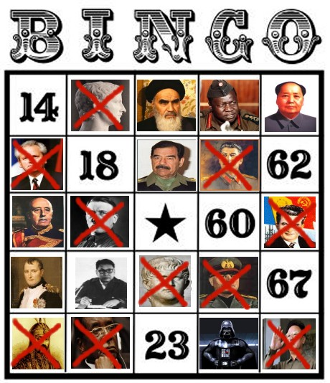
Discussion
Pronouns
Increased third-person singular pronouns, increased probability of support of war
Emphasis on eliminating evil dictators
wingsoverscotland.com/wp-content/uploads/2012/02/salmondbingo1.jpg

Slide 21
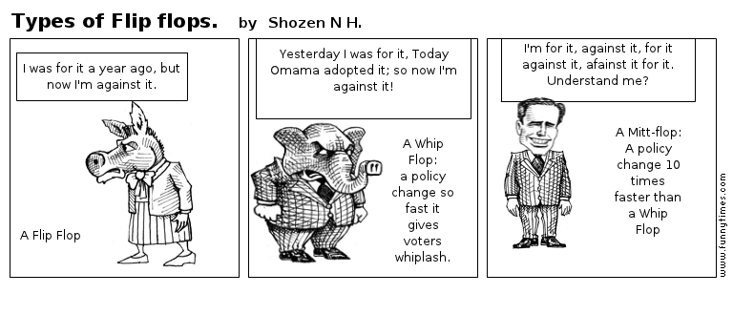
Limitations
Defining “support for war”
Nature of political speeches

Slide 22
Future Directions
More language samples
Moral Foundations Theory
Perceived violations of moral foundations could be one possible cause of intergroup conflict (Kesebir & Pyszczynski, 2011)
Hypothesize correlations between use of moral words and the use of words found to be important in the first study in predicting support for war

Slide 23
References
Babones, S. (2012). The Revival of Militarist Language in the United States. Peace Review, 24(1), 84-91. doi:10.1080/10402659.2012.651030
Bugarski, R. (2000). Discourses of War and Peace. Folia Linguistica, 34(3/4), 129-145.
Cohn, M. A., Mehl, M. R., & Pennebaker, J. W. (2004). Linguistic Markers of Psychological Change Surrounding September 11, 2001.Psychological Science (Wiley-Blackwell), 15(10), 687-693. doi:10.1111/j.0956-7976.2004.00741.x
Esch, J. (2010). Legitimizing the “War on Terror”: Political Myth in Official-Level Rhetoric. Political Psychology, 31(3), 357-391. doi:10.1111/j.1467-9221.2010.00762.x
Hogenraad, R. (2005). What the Words of War Can Tell Us About the Risk of War. Peace And Conflict: Journal Of Peace Psychology,11(2), 137-151. doi:10.1207/s15327949pac1102_2
Pennebaker, J.W. (2011). The secret life of pronouns: What our words say about us. New York: Bloomsbury Press.
Pennebaker, J.W., Booth, R.J., & Francis, M.E. (2007). Linguistic Inquiry and Word Count: LIWC 2007. Austin, TX: LIWC (www.liwc.net).
Slatcher, R. B., Chung, C. K., Pennebaker, J. W., & Stone, L. D. (2007). Winning words: Individual differences in linguistic style among U.S. presidential and vice presidential candidates. Journal Of Research In Personality, 41(1), 63-75. doi:10.1016/j.jrp.2006.01.006
Tausczik, Y. R., & Pennebaker, J. W. (2010). The Psychological Meaning of Words: LIWC and Computerized Text Analysis Methods.Journal Of Language & Social Psychology, 29(1), 24-54. doi:10.1177/0261927X09351676

Slide 24
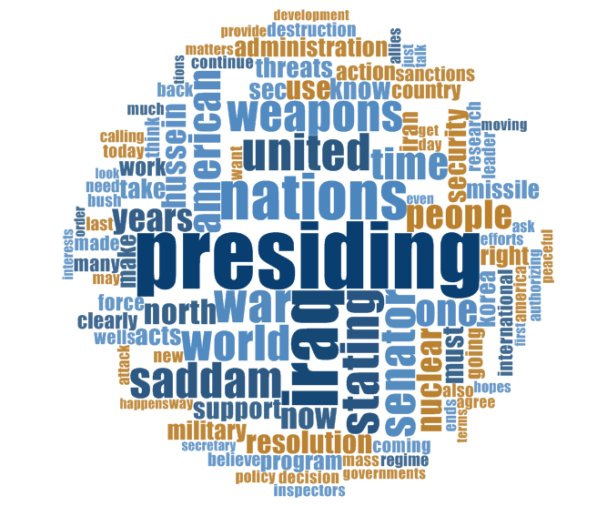
Contact: kaylajordan91@gmail.com

